Slide 1


IAM (IDENTITY ACCESS MANAGEMENT)

Slide 2


AGENDA
What is AWS IAM?
Key Components of IAM
MFA
Access Keys
Permission Boundaries
Conclusion

Slide 3
What is (iam) ?
Identity and Access Management
AWS IAM allows you to manage access to AWS services and resources securely.
Provides fine-grained access control across all of AWS.
You can manage who is authenticated (signed in) and authorized (has permissions) to use resources.

Slide 4

“Key Components of IAM”
Users
Groups
Roles
Policies

Slide 5


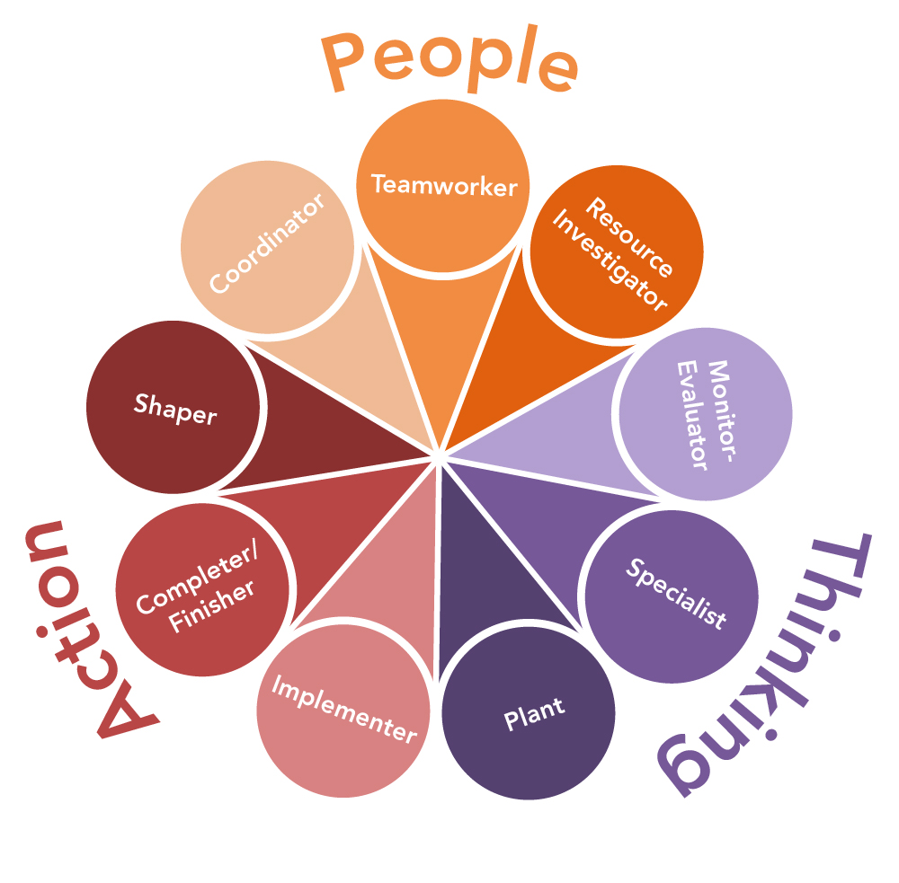

Individual accounts representing a person or service.
USER
Collection of users with common permissions.
GROUP
A way to grant permissions to trusted entities (users or services).
ROLES
JSON documents that define permissions.
POLICIES

Slide 6

USERS
IAM users are identities you create in AWS that represent individuals or services that need access to AWS resources. A user can be an actual person, such as a developer, or a service, such as an application.
Attributes:
Users can be assigned long-term credentials like passwords and access keys.
A user starts with no permissions and needs policies attached to gain access to AWS resources.
Each user has a unique username and can be placed into one or more IAM groups.

Slide 7
GROUPS
A group is a collection of IAM users, and it simplifies permissions management by allowing you to assign permissions to multiple users at once.
Attributes:
Policies applied to a group are automatically applied to all users within the group.
Groups are used to organize users by their role or responsibility (e.g., Admins, Developers, T esters).
A user can belong to multiple groups.

Slide 8
roles
IAM roles are a way to grant permissions to entities (users or services) without using long-term credentials.
Attributes:
Roles can be assumed by users, applications, or services to access AWS resources.
Roles are temporary and provide short-term credentials, reducing the risk of credential compromise.
Roles are commonly used for cross-account access and to grant permissions to AWS services like EC2 or Lambda.

Slide 9
policies
Policies are documents that define permissions and are used to control what actions a user, group, or role can perform on AWS resources.
Policies are written in JSON and consist of "Effect" (Allow/Deny), "Action" (the operation), and "Resource" (what is being acted upon).
Managed Policies: AWS-created or customer-created reusable policies.
Inline Policies: Directly attached to a single user, group, or role.
Policy Types:
Identity-based policies: Grant permissions to users, groups, or roles.
Resource-based policies: Define permissions on resources like S3 buckets or SNS topics.
Permissions boundaries: Define maximum permissions that a user or role can have.
Service control policies (SCPs): Used in AWS Organizations to manage permissions across multiple accounts.

Slide 10
Multi-Factor Authentication (MFA)
MFA is an additional security layer that requires users to provide not just a password, but also a code from an MFA device (like an authenticator app or hardware token).
Attributes:
Adds a layer of protection to user accounts.
Can be applied to individual users or accounts.
Typically used for privileged users with access to sensitive data or administrative functions.
Use Case: Enforce MFA for all administrative users to ensure their accounts are highly secure.

Slide 11
Access Keys
Access keys are long-term credentials used to authenticate programmatic requests to AWS services (e.g., via the AWS CLI or SDKs).
Attributes:
Consist of an access key ID and a secret access key.
Should be rotated regularly and not hard-coded in applications.
Only used for programmatic access, not for AWS Management Console access.
Use Case: Generate access keys for a service running outside AWS (e.g., a third-party application) that needs to interact with AWS resources like S3.

Slide 12
Permissions Boundaries
Permissions boundaries are an advanced feature that allows you to set maximum permissions for IAM roles or users.
Attributes:
It ensures that even if users or roles have policies that grant more permissions, they cannot exceed the permissions defined by the boundary.
Helps prevent excessive permission assignments.
Use Case: Limit a role's permissions to prevent it from accidentally gaining access to sensitive resources, even if someone mistakenly attaches a more permissive policy.

Slide 13
These key components of AWS IAM work together to provide a secure and flexible way to manage access to AWS resources. Each component plays a specific role in ensuring that only authorized users and services can access resources, with appropriate permissions.
CONCLUSION

